Slide 1

Battle of the Neighborhoods:
New York
Richard Min
Richard Min

Slide 2
Introduction/Objective:
In this project, I am trying to find the best location to start a sushi restaurant in New York City
Using Foursquare API to collect the common venues for each neighborhood
Using unsupervised machine learning, k-means clustering, to form groups of neighborhoods based on their venues

Slide 3
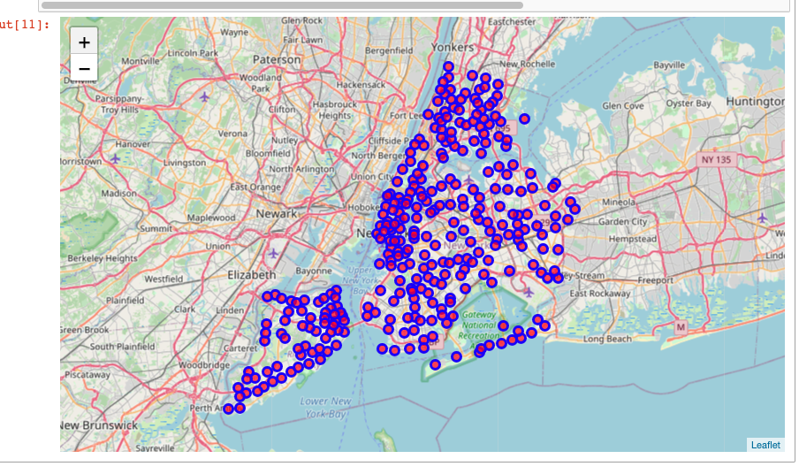
Map of New York City with Neighborhoods

Slide 4
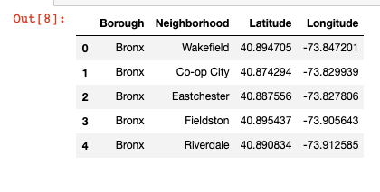
Data Acquisition
https://geo.nyu.edu/catalog/nyu_2451_34572
This was used to for the dataset of New York City
4 Features:

Slide 5
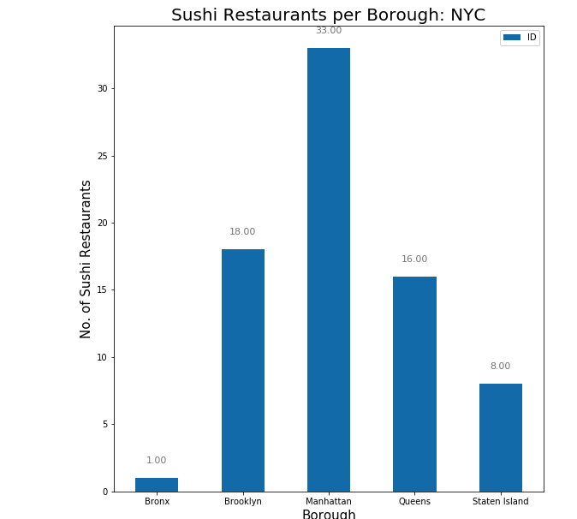
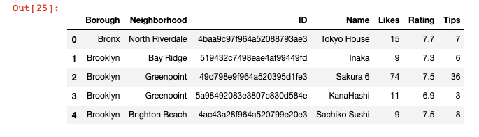
Data
Created a dataset that includes other info such as ID, Name of restaurant, rating, and tips and the amount of sushi restaurants in each borough

Slide 6
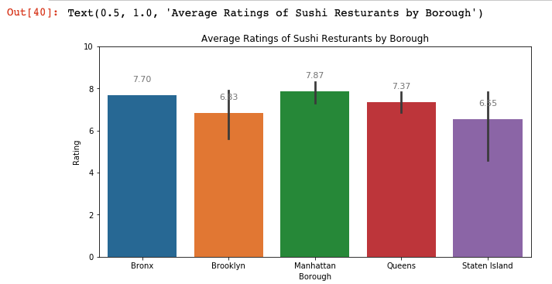
Average Rate of Sushi Restaurant
Manhattan seems to have the most sushi restaurants and the best rated sushi

Slide 7
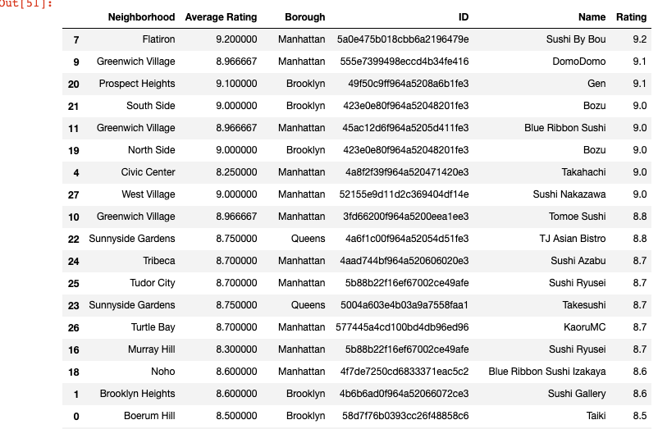
Dataset of the Top Rated Sushi Restaurant >= 8
Not the whole dataset

Slide 8
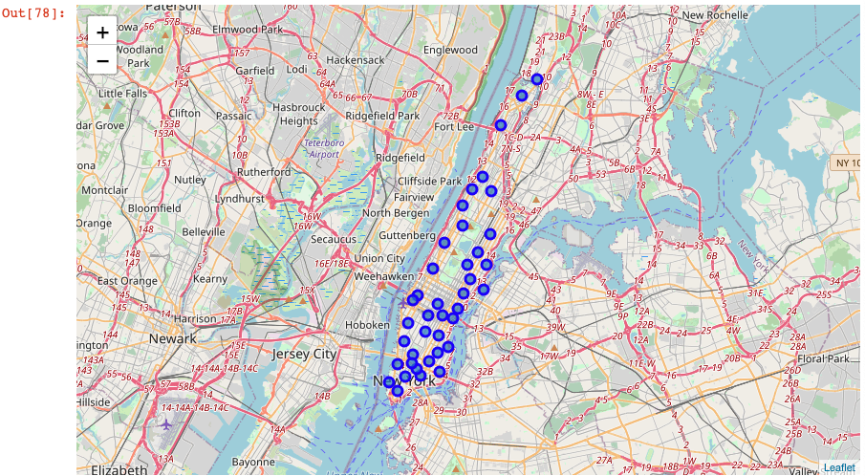
Map of Manhattan with Neighborhoods

Slide 9
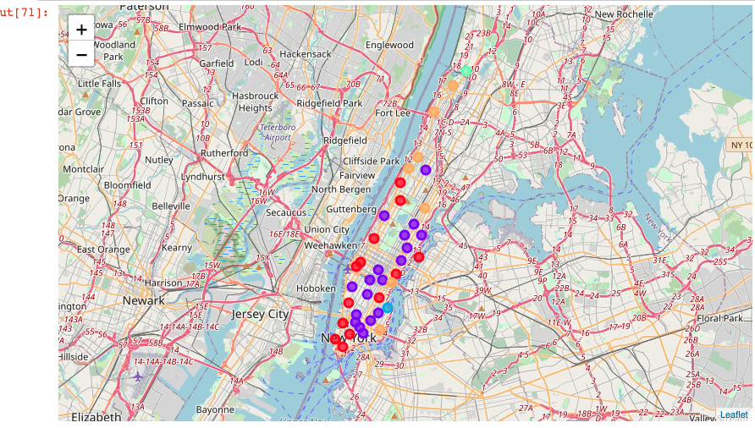
Map of Manhattan with Clusters

Slide 10
Results
The best rated sushi restaurant is Sushi by Bou with a score of 9,2 in Flatiron, Manhattan
Manhattan had the most sushi restaurants that had a rating score of 8 or more
Manhattan had 18 of 29 top rated sushi restaurant

Slide 11
Conclusion:
The best area to open a sushi restaurant would be Manhattan, New York. In that area, most of the top rated sushi restaurants are located and it is known to be an area of fine cuisine. Not only is there a lot of restaurants in Manhattan, there are a lot of other venues that people can visit so that there are always people in that area, leading to more potential customers.

